Slide 1

Building the Pipeline for Enterprise Services

Slide 2
Outline
List of Ideas
Opportunity Alignment
Establish the Pipeline
Building the Product Roadmap
Suggested Next Steps
Appendix

Slide 3
List of Ideas
Idea/Job | Domain | Opportunity (Desired Outcomes)
Universal Registry Service for component architectures | ALL | Reduce the complexity required to manage service architectures (internal & external to enterprises) Improve the performance with utility-based services for 3rd party service providers Increase the likelihood that medical devices can leverage remote computing resources
Virtual Service Bus with prioritization and queue management for services w/in a company, w/in a cloud, and w/ 3rd parties. | ALL | Increase the likelihood that 3rd party services can be aligned with enterprise services to create a holistic capability Reduce the amount of time required for services to locate resources to complete complex transactions Increase the likelihood that enterprises are able to consume 3rd party services
Optimized routing for messaging services (key opportunity for utility-based computing) | ALL | Reduce the bandwidth costs associated with high volume computing in distributed environments Increase the likelihood that companies are able to scale their business services for internal and external customers.

Slide 4
List of Ideas
Idea/Job | Domain | Opportunity (Desired Outcomes)
Separate management of private / stealth communications for government | Government | Increase the likelihood that government resources are able to support secure communications with stealth resources (i.e. computing nodes, wireless objects, satellites). Reduce the costs associated with routing information to stealth operations (esp. mobile operations) Improve the ability to track activity associated with stealth communications.
3rd party management for identity management | ALL | Increase the likelihood that enterprise assets can be tracked and managed across distributed locations. Reduce the likelihood of enterprises needing to build and maintain their own identity management infrastructures Increase the likelihood that collaboration between enterprises can be managed in a secure manner Reduce the complexity associated with managing silos of resources (human, computing, logical, and physical assets). Increase the likelihood that security can be maintained as the number of corporate assets increase Increase the likelihood that security can be maintained as the corporate assets are increasingly made accessible to 3rd party assets.

Slide 5
List of Ideas
Idea/Job | Domain | Opportunity (Desired Outcomes)
Metadata Management | ALL | Reduce the effort required to support Metadata for business analytics Reduce the amount of time required to capture collaborative knowledge Reduce the likelihood that Metadata will not grow out of control Increase the likelihood that knowledge workers are able to find the right knowledge for the job they are performing Increase the likelihood that corporate data can be more easily managed if metadata is abstracted from their operational data stores
Managing High Volume Computing/Analytics | ALL | Reduce the costs for maintaining large data stores Reduce the complexity associated with managing Very Large Databases Reduce the amount of time that information is not accessible due to backend performance issues (backup, restores, indexing) Reduce the amount of time required to deliver business intelligence Increase the likelihood that customers are more proactive with identifying areas of opportunity Increase the likelihood that customers are more proactive with identifying areas of concern (problems and/or patterns that might lead to problems)

Slide 6
Opportunity Alignment
Align our thoughts on areas of opportunity.
Conduct a domain analysis to narrow the focus.
Conduct a Job Study to capture a list of jobs that we might want to study in detail.
Identify which jobs we want to study in more detail.
Establish a formal Customer Focus program for building an opportunity pipeline.

Slide 7
Establish the Pipeline
Qualitative Phase:
Job Study for Project Scope
Prioritize the jobs to study
Develop an interview plan
Conduct interviews (capture outcomes)
Analyze outcomes & complete analysis
Quantitative Phase:
Draft survey (using outcomes)
Conduct survey (measure outcomes)
Analyze results & identify opportunities
Present findings to Leadership.
Based on the Strategyn Methodology (see appendix)

Slide 8
Establish the Pipeline
Establishing the opportunity pipeline
Prioritize the list of opportunities
Introduce tools for generating ideas (to address opportunities)
Generate ideas that address one or more desired outcomes
Establish a process to select the best ideas
Multi-Opportunity Ideas are usually the best
Select the best ideas & agree upon list of recommendations to pursue
Present top ideas to the leadership with recommendations
Transition ideas to innovation
Gain approval to pursue recommendations
Assigns ownership to develop & implement changes
Create new products & services
Modify existing products & services

Slide 9
Building the Product Roadmap
Create a reference model for defining the jobs from which value is derived.
Build a repository of metrics that the company can use to measure the value that customers want to obtain.
Map the value metrics against the services and products used to deliver value to customers.
Identify opportunities (gaps between what is delivered versus what customers want) to improve services & products.
Identify products & services that the company can deliver sustainable value.

Slide 10
Suggested Next Steps
Jeff to provide his ideas (template). Done
Jeff to provide a strawman to establish a pipeline and move forward. Done
Mario & Team to provide their ideas.
All to review/align on the strawman.
Agree on goals & deliverables for dialogue.
Schedule face-to-face dialogue.

Slide 11
Appendix
(Overview of Strategyn Methodology)

Slide 12
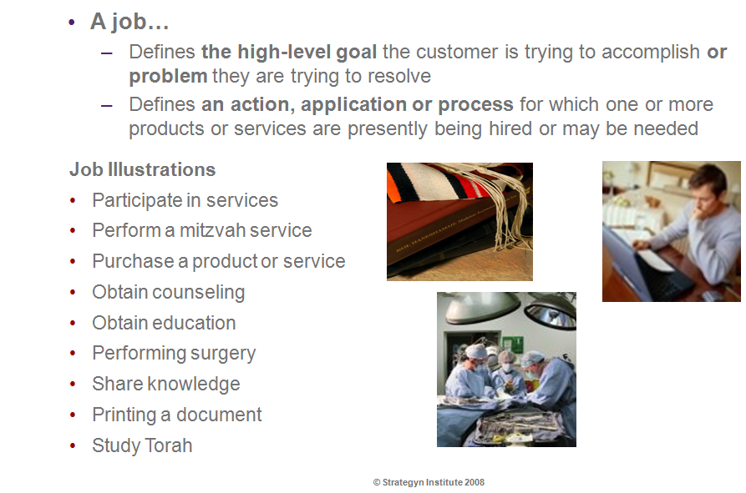
What is a Job ?

Slide 13
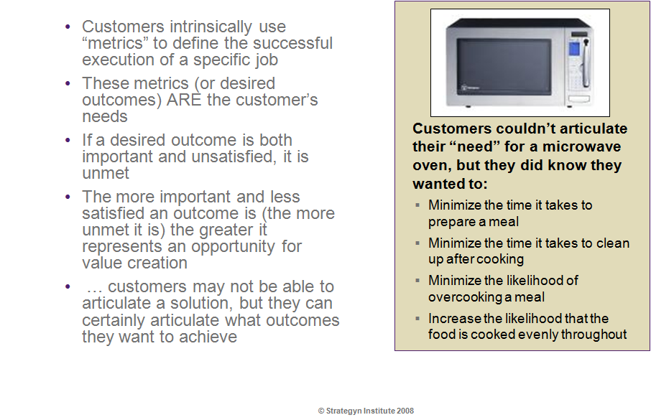
What are outcomes ?

Slide 14
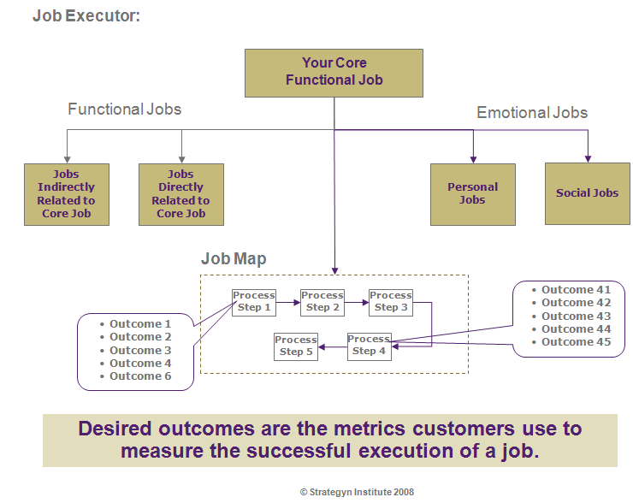
Model for Relating Jobs & Outcomes

Slide 15
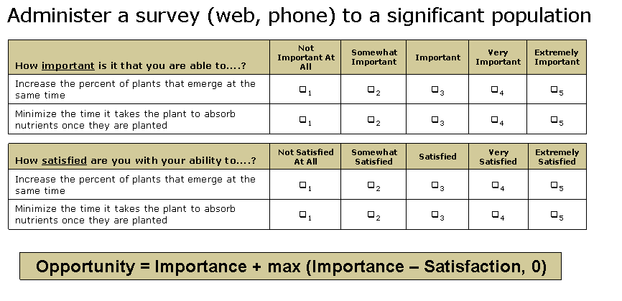
Capturing & Measuring Value

Slide 16
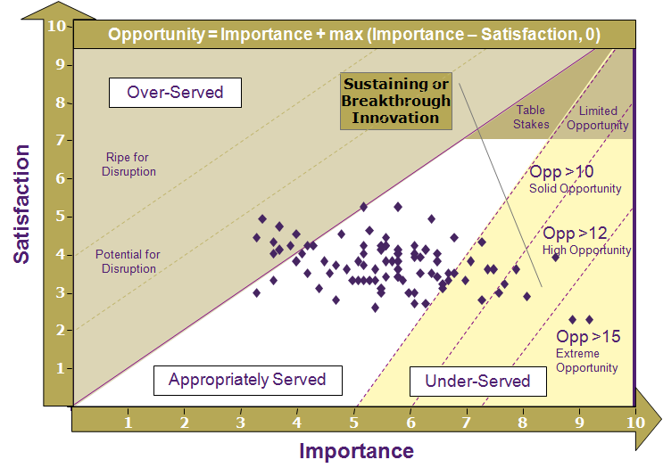
Identifying & Prioritizing Opportunities

Slide 17
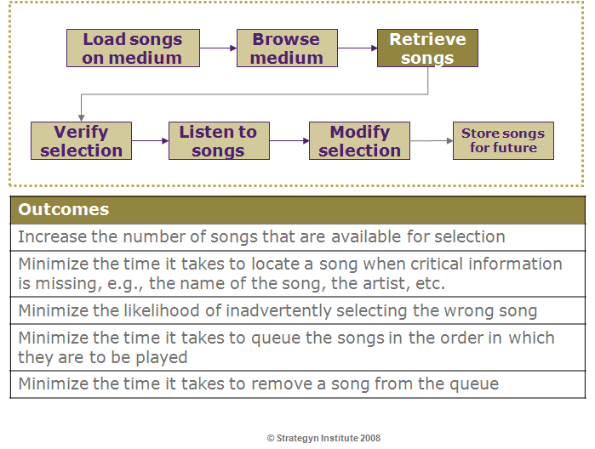
Example: Job of Storing & Retrieving Music

